Slide 1
Introduction to Programming
Instructor: Jhun Brian M. Andam

Slide 2
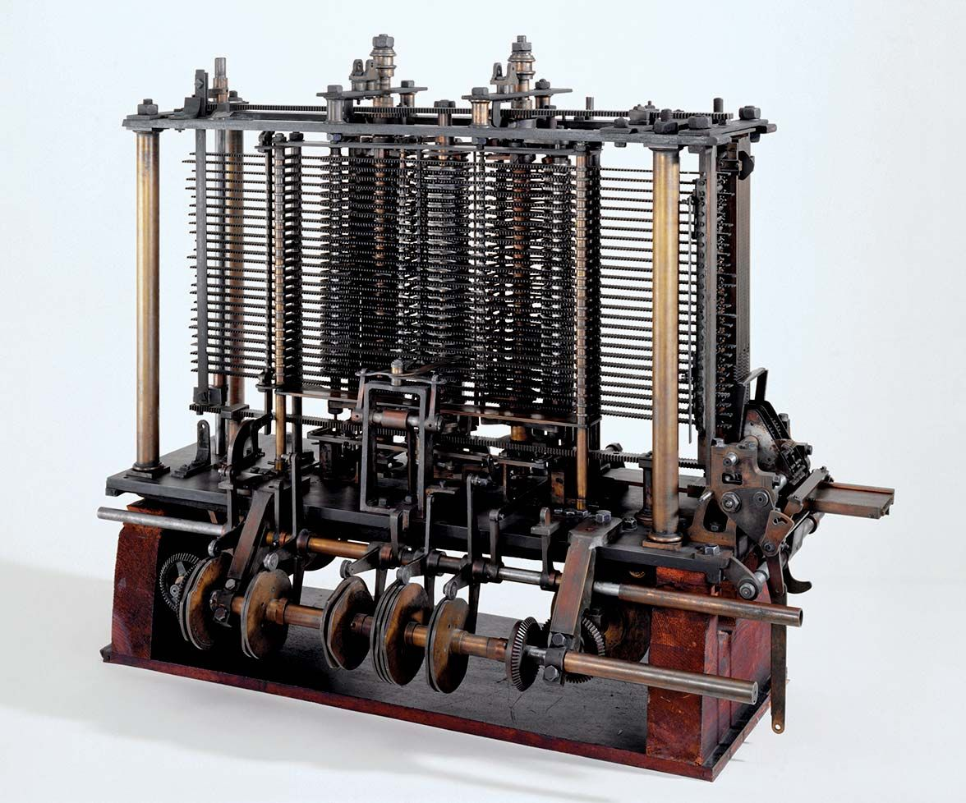
The analytical Engine
The Analytical Engine, designed by Charles Babbage in the 1830s, was a remarkable invention that was conceived with several purposes in mind, even before Ada Lovelace made her pioneering contributions to the concept of programming it. Babbage's vision for the Analytical Engine included the following primary purposes:
Mathematical Calculations
Error Reduction
Data Processing
Mechanical Automation
Notes:
It's important to note that while Babbage's design had these intended purposes, the Analytical Engine was never built during his lifetime due to various technical and financial challenges. Ada Lovelace's contributions, particularly her notes on the machine and her insights into programming it, played a significant role in recognizing the broader potential of the Analytical Engine as a general-purpose computing machine, capable of executing instructions to perform various tasks beyond mathematical calculations. Lovelace's work laid the foundation for modern computer programming and earned her the title of the world's first computer programmer.

Slide 3
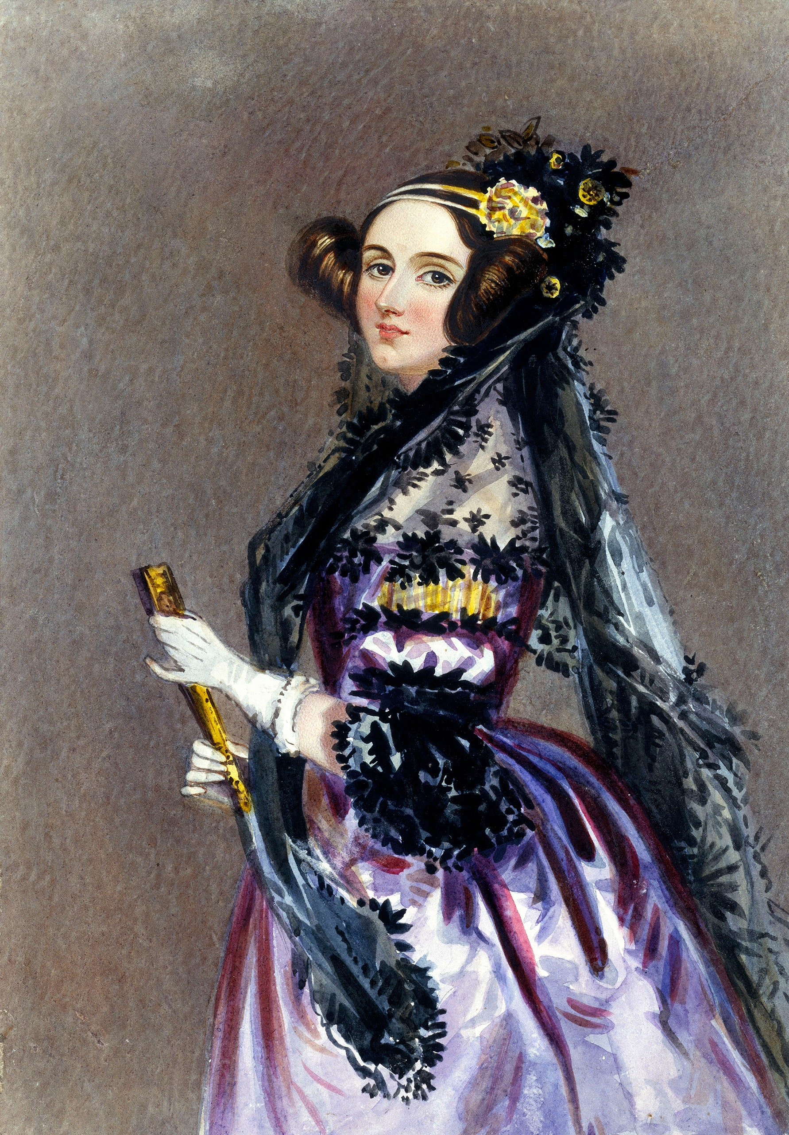
ADA lovelace
Augusta Ada King, Countess of Lovelace (née Byron; 10 December 1815 – 27 November 1852) was an English mathematician and writer, chiefly known for her work on Charles Babbage's proposed mechanical general-purpose computer, the Analytical Engine. She was the first to recognize that the machine had applications beyond pure calculation.
Notes:
Ada Lovelace not only understood the basic principles of the Analytical Engine but also saw that it could be used for more than just mathematical calculations. She believed that this machine had broader applications, such as generating music and creating art. In other words, she recognized that the Analytical Engine could be programmed to perform various tasks, not limited to arithmetic, which is a foundational concept in the development of computer programming.
This visionary perspective is significant because it laid the groundwork for the modern understanding of programming, where computers can be programmed to perform a wide range of tasks beyond simple numerical calculations. Ada Lovelace's recognition of the machine's potential for general-purpose computation was ahead of her time and has had a lasting impact on the field of computer science and technology.

Slide 4
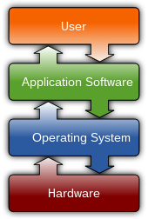
What is a software?
A software is a set of computer programs and associated documentation and data. This is in contrast to hardware, from which the system is built and which actually performs the work.
Notes:
The diagram shows how the user interacts with application software on a typical desktop computer. The application software layer interfaces with the operating system, which in turn communicates with the hardware. The arrows indicate information flow.
User wants to perform a task or use an application on their computer.
Application serves the user's request by providing the functionality they need.
OS acts as the intermediary, managing and coordinating interactions between applications and hardware.
Hardware carries out the specific actions needed to fulfill the user's request based on instructions from the OS.
Information and commands flow back and forth between these components to ensure that the user's task is completed effectively and that the hardware operates efficiently.

Slide 5
Application or Software?
An application, also referred to as an application program or application software, is a computer software package that performs a specific function directly for an end user or, in some cases, for another application. An application can be self-contained or a group of programs.
Notes:
It is designed to perform a specific function or task.
The primary user of an application is the end user, which could be an individual or an organization.
Sometimes, applications can also serve as tools for other applications, meaning they can be used by other software programs to perform certain functions.
An application can either be self-contained, meaning it operates independently, or it can consist of a group of programs working together to achieve a specific goal or functionality.

Slide 6

Notes:
Computer programs, known as software, are instructions that tell a computer what to do.

Slide 7
Computers do not understand human languages, so programs must be written in a language a computer can use. There are hundreds of programming languages, and they were developed to make the programming process easier for people. However, all programs must be converted into a language the computer can understand.

Slide 8
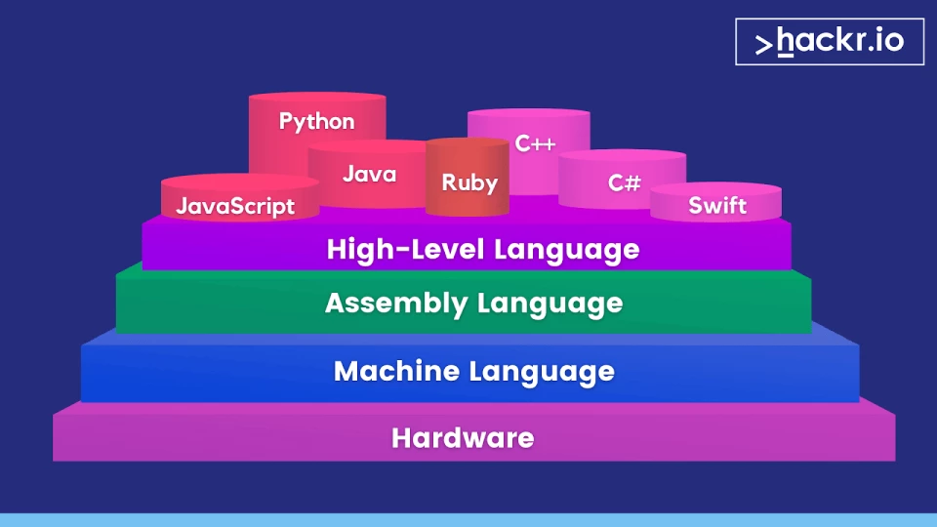
Level of abstraction in programming
Notes:
In simple words, the "level of abstraction" in programming refers to how close or how far you are from the detailed inner workings of a computer or software system when you're writing code.

Slide 9
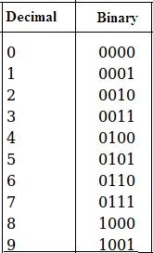
Machine language
Machine language instructions typically use some bits to represent operations, such as addition, and some to represent operands, or perhaps the location of the next instruction. Machine language is difficult to read and write, since it does not resemble conventional mathematical notation or human language, and its codes vary from computer to computer.
A computer’s native language, which differs among different types of computers, is its machine language - a set of built-in primitive instructions. These instructions are in the form of binary code, so if you want to give a computer an instruction in its native language, you have to enter the instruction as binary code. For example, to add two numbers, you might have to write an instruction in binary code, like this:
1101101010011010
Notes:
In computing, a "bit" is the smallest unit of data and the fundamental building block of digital information. The term "bit" is an abbreviation for "binary digit." A bit can have one of two values: 0 or 1, representing the two binary states in computing. These binary values are often associated with the presence or absence of an electrical charge in electronic circuits or the presence or absence of a signal.

Slide 10
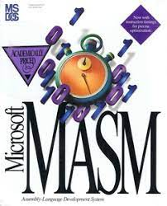
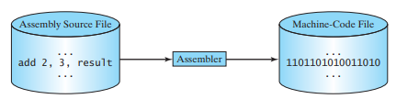
ASSEMBLY language
Assembly language (alternatively assembler language or symbolic machine code), often referred to simply as assembly and commonly abbreviated as ASM or asm, is any low-level programming language with a very strong correspondence between the instructions in the language and the architecture's machine code instructions.
Notes:
Programming in machine language is a tedious process. Moreover, programs written in machine language are very difficult to read and modify. For this reason, assembly language was created in the early days of computing as an alternative to machine languages. Assembly language uses a short descriptive word, known as mnemonic, to represent each of the machine language instructions. For example, the mnemonic add typically means to add numbers and sub means to subtract numbers. To add the numbers 2 and 3 and get the result, you might write an instruction in assembly code like this:
add 2, 3, result
Assembly languages were developed to make programming easier. However, because the computer cannot understand assembly language, another program—called an assembler—is used to translate assembly-language programs into machine code.
Writing code in assembly language is easier than in machine language. However, it is still tedious to write code in assembly language. An instruction in assembly language essentially corresponds to an instruction in machine code. Writing in assembly requires that you know how the CPU works. Assembly language is referred to as a low-level language, because assembly language is close in nature to machine language and is machine dependent.

Slide 11
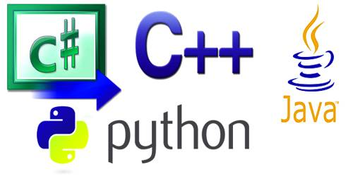

High-level language
In the 1950s, a new generation of programming languages known as high-level languages emerged. They are platform-independent, which means that you can write a program in a high-level language and run it in different types of machines. High-level languages are English-like and easy to learn and use. The instructions in a high-level programming language are called statements. Here, for example, is a high-level language statement that computes the area of a circle with a radius of 5:
$A=πr^{2}$
A = 3.1415 * 5 * 5

Slide 12
Programming languages
Language | Short Description
Ada | Mainly used for defense projects
BASIC | Beginner’s All-purpose Symbolic Instruction Code.
C | C combines the power of an assembly language with the ease of use and portability of a high-level language.
C++ | OO language based on C.
C# | Hybrid of java and C++.
COBOL | Common Business Oriented Language. Used for business applications.
FORTRAN | Formula Translation. Popular for scientific and mathematical applications.
Java | Widely used for developing platform-independent Internet applications.
Pascal | Structured general-purpose language primarily for teaching programming.
Python | A simple general-purpose scripting language good for writing short programs.
Visual Basic | Enables the programmers to rapidly develop Windows-based applications.
There are many high-level programming languages, and each was designed for a specific purpose. A program written in a high-level language is called a source program or source code. Because a computer cannot understand a source program, a source program must be translated into machine code for execution. The translation can be done using another programming tool called an interpreter or a compiler.

Slide 13
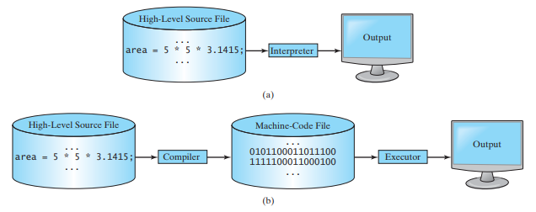
Notes:
An interpreter translates and executes a program one statement at a time.
A compiler translates the entire source program into a machine-language file for execution.
Python code is executed using an interpreter. Most other programming languages are processed using a compiler

Slide 14
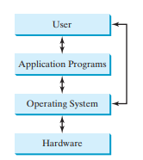
operating systems
The popular operating systems for general-purpose computers are Microsoft Windows, Mac OS, and Linux. Application programs, such as a Web browser or a word processor, cannot run unless an operating system is installed and running on the computer.
The major tasks of an operating system are:
Controlling and monitoring system activities.
Allocating and assigning system resources.
Scheduling operations.

Slide 15
Controlling and monitoring system activities
Operating systems perform basic tasks, such as recognizing input from the keyboard, sending output to the monitor, keeping track of files and folders on storage devices, and controlling peripheral devices, such as disk drives and printers. An operating system must also ensure that different programs and users working at the same time do not interfere with each other. In addition, the OS is responsible for security, ensuring that unauthorized users and programs do not access the system.

Slide 16
Allocating and assigning system resources
The operating system is responsible for determining what computer resources a program needs (such as CPU time, memory space, disks, input and output devices) and for allocating and assigning them to run the program.

Slide 17
Scheduling Operations
The OS is responsible for scheduling programs’ activities to make efficient use of system resources. Many of today’s operating systems support such techniques as multiprogramming, multithreading, and multiprocessing to increase system performance.

Slide 18
Scheduling Operations
Multiprogramming enables multiple programs to run concurrently on a single CPU, making use of its idle time. This improves efficiency as the CPU is often waiting for tasks like data transfers or system resource responses. For instance, it allows you to edit a file with a word processor while your web browser downloads a file simultaneously.
Multithreading allows a single program to execute multiple tasks at the same time. For instance, a word-processing program allows users to simultaneously edit text and save it to a disk. In this example, editing and saving are two tasks within the same application. These two tasks may run concurrently.
Multiprocessing, or parallel processing, uses two or more processors together to perform subtasks concurrently and then combine solutions of the subtasks to obtain a solution for the entire task. It is like a surgical operation where several doctors work together on one patient.

Slide 19
Let’s wrap it up
What language does the CPU understand?
What is an assembly language?
What is an assembler?
What is a high-level programming language?
What is an interpreter and a compiler?
What are the major responsibilities of an operating system?
Notes:
The CPU primarily understands machine code, which consists of binary instructions represented as 0s and 1s.
Assembly language is a low-level programming language that represents machine code instructions using human-readable symbols and mnemonics. It offers direct control over hardware and is used for optimizing specific tasks.
An assembler is a tool that converts assembly language code into machine code for execution by a computer's CPU.
A high-level programming language is designed for human-readable coding and abstracts low-level hardware details for ease of use in software development.
An interpreter is a program that reads and executes high-level code line by line, translating it into machine code on-the-fly.
A compiler is a program that translates entire high-level code into machine code all at once, producing a separate executable file.
Controlling and monitoring system activities.
Allocating and assigning system resources.
Scheduling operations.

Slide 20
Activity
Divide the class into 10 groups.
Research about the assigned algorithm.
Make an outline of discussion to be submitted by the end of the period.
Definition and concept of the algorithm.
General idea of the algorithm.
Applications of the algorithm
Basic procedure (steps)
Complexity Analysis (e.g, time and space)

Slide 21
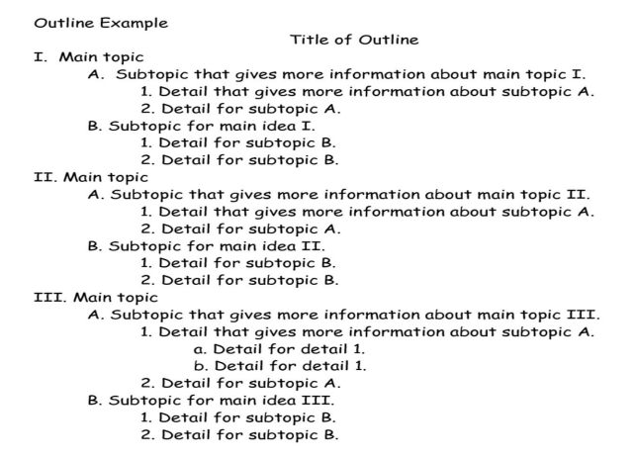
Activity

Slide 22
References
https://en.wikipedia.org/wiki/Software
https://www.techtarget.com/searchsoftwarequality/definition/application#:~:text=An%20application%2C%20also%20referred%20to,or%20a%20group%20of%20programs.

